Slide 1
Programming for ECE
Week
Part 3
6

Slide 2

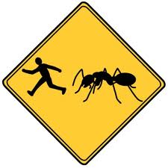
Agenda
Files
Text Files
Binary Files
Sequential vs. Random Access

Slide 3
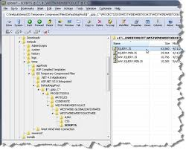
File I/O
What is a file?
Looking at files
Programming for files
Types:
Text
Binary
Techniques:
Open
Read
Write
Demo

Slide 4

What is a file?
file:
(n.) A collection of data, information, or executable code that is stored on media (disk, iPod, flash drive, etc.).
Every file has a file name that the hardware's operating system can use to identify the file.
Files usually have a path name the hardware's operating system can use to locate the file.

Slide 5

Types of Files
Fundamentally two types:
text
binary
Either type can contain:
Data:
text file can contain user data, config data, OS data, etc.;
ex: mystuff.txt
binary file can contain "enhanced" data; ex: Word, Excel, Powerpoint, etc.
ex: Lab1.docx
Executable code:
text file can contain scripts or interpreted code
dothis.bat
binary file can contain executable code (created from compiled source and object code) or intermediate code that can be linked, interpreted, et. al.
Lab1.exe, Word.app

Slide 6
Text Files
Dalton,Andy,QB
Green,A.J.,WR
Green-Elis,BenJarvus,RB
Terminology:
Each line is a record
The line ends with
a Carriage Return (CR) character (hex OD)
Windows default
a New Line (NL) character (hex OA)
all systems
Each record can have fields
Distinct data items
Fields are separated by delimitors

Slide 7
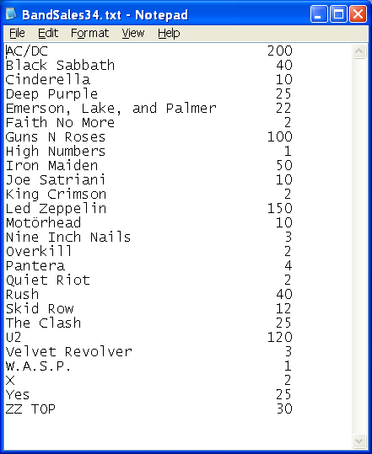
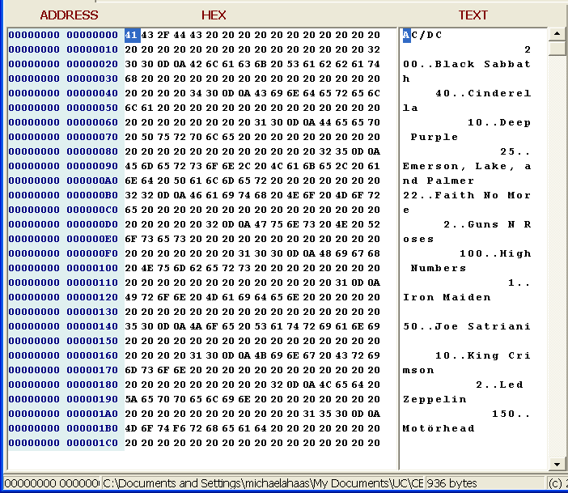
Text File
Example:

Slide 8
Text files
A text file:
is human-readable
but, you may not be able to see every character in the file
consists of lines of text
separated by carriage return/line feed characters (Hex OD OA)*
Can be edited by Notepad, Excel, Word, Visual Studio
* system dependent, may just be 0A

Slide 9



What's really in a file?
You need a File Viewer – not a text editor – to see what is really inside of a file:
PC: Universal Viewer
Mac: File Viewer on Apple App Store

Slide 10
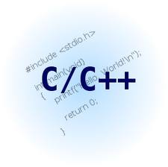
Text Files
Code samples:
C-style I/O:
stdio.h
Not covered in this class
See online references (ex: cplusplus.com stdio library section)
C++ I/O:
Files++.cpp
reads/writes text from/to a file
reads/writes integers from/to a file
reads/writes contents of a struct from/into a file
files++.cpp Posted on Blackboard

Slide 11
Text Files
Important to remember:
Easy to use
Don't forget about the OD OA
carriage return & line feed:
check to see if input and output commands delete or retain them
will affect the length of an input/output string

Slide 12
Text File
Each line terminates with OD OA :

Slide 13

So how do I use files?

Slide 14
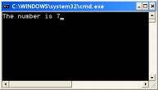
Flashback to Week I
Remember streams?
cin reads the stream from the keyboard
cout writes a stream to the display
5
5
steve
int steve;
cin >> steve;
cin >> steve;
int var1 = 7;
cout << “The number is ” << var1;

Slide 15
In and Out
How do you get data into a file?:
A program writes data from the program to an output file
using an output stream
How do you get data out of a file?
A program reads data from an input file to the program
using an input stream
Here is line 0
Here is line 1
Here is line 2
Here is line 3
Here is line 4
Here is line 5
Here is line 6
Here is line 7
Here is line 8
Here is line 9
Here is line 0
Here is line 1
Here is line 2
Here is line 3
Here is line 4
Here is line 5
Here is line 6
Here is line 7
Here is line 8
Here is line 9
Program
Read
Write
Input File
Output File

Slide 16
Writing a Text File in C++
Got to have this if you are reading/writing files
Here is line 0
Here is line 1
Here is line 2
Here is line 3
Here is line 4
Here is line 5
Here is line 6
Here is line 7
Here is line 8
Here is line 9
#include <iostream>
#include <fstream>
#include <string>
// *********************************************************
// ************ Writing Text to a File *********************
// *********************************************************
// note: all C++ I/O is a stream of characters
ofstream fileobject(filename.c_str());
for (linecount = 0; linecount < 10; linecount++)
{
fileobject << "Here is line " << linecount << endl;
}
fileobject.close();

Slide 17

And, that's it!
Just like writing to the display
Just like cout
except you write to a file object
That's it! All done with writing text files!

Slide 18
And, that's it!
You need:
#include <fstream> // library
ofstream fileobject(filename.c_str()); // open
fileobject << "Output text" << var1 << endl; // write
fileobject.close(); // close

Slide 19

So, is reading a file easy too?
No
But it is like getline()
In fact, it's a lot like getline()

Slide 20
Reading a Text File in C++
Got to have this if you are reading/writing files
Here is line 0
Here is line 1
Here is line 2
Here is line 3
Here is line 4
Here is line 5
Here is line 6
Here is line 7
Here is line 8
Here is line 9
#include <iostream>
#include <fstream>
#include <string>
string filename = "Test.txt";
// *********************************************************
// ************ Reading Text from a File *******************
// *********************************************************
// note: all C++ I/O is a stream of characters
ifstream infile ( filename.c_str() , ifstream::in );
string inputline;
while ( infile.good() )
{
getline( infile, inputline);
cout << inputline << endl;
} // end while
infile.close();

Slide 21
Reading a Text File in C++
Got to have this if you are reading/writing files
Here is line 0
Here is line 1
Here is line 2
Here is line 3
Here is line 4
Here is line 5
Here is line 6
Here is line 7
Here is line 8
Here is line 9
#include <iostream>
#include <fstream>
#include <string>
string filename = "Test.txt";
// *********************************************************
// ************ Reading Text from a File *******************
// *********************************************************
// note: all C++ I/O is a stream of characters
ifstream infile ( filename.c_str() , ifstream::in );
string inputline;
while ( infile.good() )
{
getline( infile, inputline);
cout << inputline << endl;
} // end while
infile.close();
Here is line 0
Here is line 1
Here is line 2
Here is line 3
Here is line 4
Here is line 5
Here is line 6
Here is line 7
Here is line 8
Here is line 9

Slide 22
Reading Text into an array
string ziptable[120][3];
int recordcount = 0;
string filename = "Test.txt" ;
ifstream newfile ( filename.c_str() , ifstream::in );
while ( recordcount < 8 )
{
getline( newfile, inputline);
// parse the input line into fields and convert
firstcomma = inputline.find_first_of( ',' );
ziptable[recordcount][0] = atoi(inputline.substr( 0,firstcomma).c_str() ) ;
lastcomma = inputline.find( ',', firstcomma+1 );
ziptable[recordcount][1] = inputline.substr(firstcomma+1, lastcomma-firstcomma -1 ).c_str() ) ;
ziptable[recordcount][2]= inputline.substr(lastcomma+1);
recordcount++;
} // end while
newfile.close();
001,003,2
004,008,3
009,011,4
012,020,4
021,024,3
025,099,5
100,120,5
121,139,4

Slide 23

Looks good, right?
string ziptable[120][3];
int recordcount = 0;
string filename = "Test.txt" ;
ifstream newfile ( filename.c_str() , ifstream::in );
while ( recordcount < 8 )
{
getline( newfile, inputline);
// parse the input line into fields and convert
firstcomma = inputline.find_first_of( ',' );
ziptable[recordcount][0] = atoi(inputline.substr( 0,firstcomma).c_str() ) ;
lastcomma = inputline.find( ',', firstcomma+1 );
ziptable[recordcount][1] = inputline.substr(firstcomma+1, lastcomma-firstcomma -1 ).c_str() ) ;
ziptable[recordcount][2]= inputline.substr(lastcomma+1);
recordcount++;
} // end while
newfile.close();
001,003,2
004,008,3
009,011,4
012,020,4
021,024,3
025,099,5
100,120,5
121,139,4

Slide 24

Checkpoint
Is everyone ok with the basic text file I/O concept?
Because…
the Read examples demonstrated the concept…
but…
There were huge problems with them

Slide 25

Here's what you think the file is:
001,003,2
004,008,3
009,011,4
012,020,4
021,024,3
025,099,4
100,120,5
121,139,4
This is a lookup table: it finds the shipping zone for the first three digits of a zip code.
For example: zip code 10445 is in Zone 4
Now it gets complicated…

Slide 26


What if the file isn't there?
string ziptable[120][3];
int recordcount = 0;
string filename = "Test.txt" ;
ifstream newfile ( filename.c_str() , ifstream::in );
while ( recordcount < 8 )
{
getline( newfile, inputline);
// parse the input line into fields and convert
firstcomma = inputline.find_first_of( ',' );
ziptable[recordcount][0] = atoi(inputline.substr( 0,firstcomma).c_str() ) ;
lastcomma = inputline.find( ',', firstcomma+1 );
ziptable[recordcount][1] = inputline.substr(firstcomma+1, lastcomma-firstcomma -1 ).c_str() ) ;
ziptable[recordcount][2]= inputline.substr(lastcomma+1);
recordcount++;
} // end while
newfile.close();
File
No Joy Here

Slide 27
What if the file is empty?
string ziptable[120][3];
int recordcount = 0;
string filename = "Test.txt" ;
ifstream newfile ( filename.c_str() , ifstream::in );
while ( recordcount < 8 )
{
getline( newfile, inputline);
// parse the input line into fields and convert
firstcomma = inputline.find_first_of( ',' );
ziptable[recordcount][0] = atoi(inputline.substr( 0,firstcomma).c_str() ) ;
lastcomma = inputline.find( ',', firstcomma+1 );
ziptable[recordcount][1] = inputline.substr(firstcomma+1, lastcomma-firstcomma -1 ).c_str() ) ;
ziptable[recordcount][2]= inputline.substr(lastcomma+1);
recordcount++;
} // end while
newfile.close();
Agony Here

Slide 28
What if there is a blank line?
string ziptable[120][3];
int recordcount = 0;
string filename = "Test.txt" ;
ifstream newfile ( filename.c_str() , ifstream::in );
while ( recordcount < 8 )
{
getline( newfile, inputline);
// parse the input line into fields and convert
firstcomma = inputline.find_first_of( ',' );
ziptable[recordcount][0] = atoi(inputline.substr( 0,firstcomma).c_str() ) ;
lastcomma = inputline.find( ',', firstcomma+1 );
ziptable[recordcount][1] = inputline.substr(firstcomma+1, lastcomma-firstcomma -1 ).c_str() ) ;
ziptable[recordcount][2]= inputline.substr(lastcomma+1);
recordcount++;
} // end while
newfile.close();
001,003,2
004,008,3
009,011,4
012,020,4
021,024,3
100,120,5
121,139,4
Pain and Agony Here

Slide 29
What if more than 8 lines?
string ziptable[120][3];
int recordcount = 0;
string filename = "Test.txt" ;
ifstream newfile ( filename.c_str() , ifstream::in );
while ( recordcount < 8 )
{
getline( newfile, inputline);
// parse the input line into fields and convert
firstcomma = inputline.find_first_of( ',' );
ziptable[recordcount][0] = atoi(inputline.substr( 0,firstcomma).c_str() ) ;
lastcomma = inputline.find( ',', firstcomma+1 );
ziptable[recordcount][1] = inputline.substr(firstcomma+1, lastcomma-firstcomma -1 ).c_str() ) ;
ziptable[recordcount][2]= inputline.substr(lastcomma+1);
recordcount++;
} // end while
newfile.close();
001,003,2
004,008,3
009,011,4
012,020,4
021,024,3
025,099,5
100,120,5
121,139,4
140,150,6
151,177,8
Pain and Misery Here

Slide 30

Many Problems Many Solutions
Know where your file is.
Exactly where it is:
for example:
C:\Music\songsfile.txt
Check to see if file opened:
ifstream myfile ( "example.txt", ios::in );
if ( myfile.is_open() )
{
// ok, read in the file
} // end if
else
{
cout << "Error Opening file: " << filename << endl;
return;
}

Slide 31
Solutions
Have while condition check for end-of-file (eof):
while ( ! newfile.eof() )
eof check immediately after a read
eof() requires a read to set the internal flags
read first, then check
if you survive eof() at the start of each line, it is likely the rest of the line is there
And…
Check for "nothing"

Slide 32


WARNING!
This solution is not intuitive.
Read the next example very carefully!

Slide 33
What if the file is empty?
string filename = "Test.txt";
string ziptable[120][3];
ifstream newfile ( filename.c_str() , ifstream::in );
getline( newfile, inputline);
while (! newfile.eof())
{
if ( inputline.length() != 0 )
{
// you got something so parse the input line into fields and convert
firstcomma = inputline.find_first_of(',');
ziptable[recordcount][0] =
inputline.substr(0,firstcomma);
lastcomma = inputline.find(',',firstcomma+1);
ziptable[recordcount][1] =
inputline.substr(firstcomma+1,lastcomma-firstcomma – 1);
ziptable[recordcount][2] = inputline.substr(lastcomma+1);
}
recordcount++; // design: do you count a blank line as a record?
getline( newfile, inputline); // read next line from file
} // end while
newfile.close();

Slide 34
What if the file isn't empty?
string filename = "Test.txt";
string ziptable[120][3];
ifstream newfile ( filename.c_str() , ifstream::in );
getline( newfile, inputline);
while (! newfile.eof())
{
if ( inputline.length() != 0 )
{
// you got something so parse the input line into fields and convert
firstcomma = inputline.find_first_of(',');
ziptable[recordcount][0] =
inputline.substr(0,firstcomma);
lastcomma = inputline.find(',',firstcomma+1);
ziptable[recordcount][1] =
inputline.substr(firstcomma+1,lastcomma-firstcomma – 1);
ziptable[recordcount][2] = inputline.substr(lastcomma+1);
}
recordcount++; // design: do you count a blank line as a record?
getline( newfile, inputline); // read next line from file
} // end while
newfile.close();
001,003,2
004,008,3
009,011,4
012,020,4
021,024,3
025,099,5
100,120,5
121,139,4
140,150,6
151,177,8

Slide 35
What about a blank line?
string filename = "Test.txt";
string ziptable[120][3];
ifstream newfile ( filename.c_str() , ifstream::in );
getline( newfile, inputline);
while (! newfile.eof())
{
if ( inputline.length() != 0 )
{
// you got something so parse the input line into fields and convert
firstcomma = inputline.find_first_of(',');
ziptable[recordcount][0] =
inputline.substr(0,firstcomma);
lastcomma = inputline.find(',',firstcomma+1);
ziptable[recordcount][1] =
inputline.substr(firstcomma+1,lastcomma-firstcomma – 1);
ziptable[recordcount][2] = inputline.substr(lastcomma+1);
}
recordcount++; // design: do you count a blank line as a record?
getline( newfile, inputline); // read next line from file
} // end while
newfile.close();
001,003,2
004,008,3
009,011,4
012,020,4
021,024,3
025,099,5
100,120,5
121,139,4
140,150,6
151,177,8

Slide 36
What about >8 lines?
string filename = "Test.txt";
string ziptable[120][3];
ifstream newfile ( filename.c_str() , ifstream::in );
getline( newfile, inputline);
while (! newfile.eof())
{
if ( inputline.length() != 0 )
{
// you got something so parse the input line into fields and convert
firstcomma = inputline.find_first_of(',');
ziptable[recordcount][0] =
inputline.substr(0,firstcomma);
lastcomma = inputline.find(',',firstcomma+1);
ziptable[recordcount][1] =
inputline.substr(firstcomma+1,lastcomma-firstcomma – 1);
ziptable[recordcount][2] = inputline.substr(lastcomma+1);
}
recordcount++; // design: do you count a blank line as a record?
getline( newfile, inputline); // read next line from file
} // end while
newfile.close();
001,003,2
004,008,3
009,011,4
012,020,4
021,024,3
025,099,5
100,120,5
121,139,4
140,150,6
151,177,8

Slide 37

It's time to be happy!
All of the biggest problems have been fixed!

Slide 38
What have we learned?
eof() is not the same as a blank line
eof() is
a function that checks an internal status flag,
looking for a flag set by "no more characters in the stream"
the absence of something (like "dark" is really the "absence of light")
eof() is not:
a thing
a character or set of characters
Note: a "blank line" is actually OD OA (carriage return & line feed)
And:
Check return values on find functions:
firstcomma = inputline.find_first_of(',');
if (firstcomma != string::npos)
ziptable[recordcount][0] = inputline.substr(0,firstcomma);

Slide 39

And even more…
Design decisions:
If it is a blank line:
do you keep it?
ignore it?
stop reading the file?
If it is an incomplete line,
do you keep it?
if so, what goes in the remaining variables?
It all comes back to:
complexity vs. reliability
knowing your data

Slide 40

Where are the files?
C/C++ does not natively know about the OS's file system
Program will read from or write to:
A specific location (full path) – this is the best way:
string filename = "C:\\My Documents\\Data\\Test.txt" ;
The default location (system dependent)
Note double back-
slashes

Slide 41
Where are the files?
Visual Studio Projects
Visual Studio:
If you run from Windows Explorer or CMD prompt
Debug Folder where the .exe file is
If you run from within Visual Studio:
Folder where the .cpp file is (folder name matches project name)
OR
The other Debug folder (subfolder of source code folder)
Lab 7
Lab7.sln
Lab 7
Debug
Lab7.cpp
Data.txt
Lab7.exe
Data.txt
Debug
Data.txt

Slide 42
Where are the files?
My Programs
Code::Blocks:
If you run from Windows Explorer or CMD prompt
bin/Debug Folder where the .exe file is
You should always test from here
If you run from within CB:
the first level
where the .cpp file is
Lab 7
Lab7.cpp
Data.txt
bin
Debug
Lab7.exe
Data.txt

Slide 43
Where are the files?
Xcode:
If you run from Terminal:
Derived Data/projectname/Build/Products/Debug
Folder where the .exe file is
Derived Data location is an Xcode Preference
You should always test from here
If you run from within CB:
project folder
where .cpp files are

Slide 44


WHERE ARE THE FILES?
This is system- and IDE-dependent; you just have to try it…
…and find the file (look at time stamp)
Be sure you know where the file is!
You can spend hours debugging your program…
only to find you were looking at the wrong file.

Slide 45

Solution
Create a specific folder to put your data files in.
Memorize (or write down) the name of that folder
Windows: Drive letter and folder name(s) and file name
Use the complete path and file name in your code:
string filename = "C:\\Music\\cTunes.txt" ;
Don't rely on the default location:
filename = "lab6.txt" ;

Slide 46

If I had a dollar…
for "wrong file location" problem that I've seen
I would be here:
Prof. Haas's boat for Monday-Wednesday

Slide 47
more file i/o tips
128,129,5
130,149,4
150,157,3
158,159,4
160,165,3
166,239,4
240,244,3
245,245,4
246,253,3
Use multiple getline functions instead of parsing lines:
string zipszones[20][3];
int count = 0;
ifstream infile("c:\\zips\\zipzone.txt", ifstream::in);
getline(infile, zipszones[count][0], ','); // read until comma
while(! infile.eof())
{
getline(infile, zipszones[count][1], ','); // read until comma
getline(infile, zipszones[count][2]); // read until end of line
count++;
getline(infile, zipszones[count][0], ',' ); //read next line till comma
}
infile.close();

Slide 48

THE BEST WAY
128,129,5
130,149,4
150,157,3
158,159,4
160,165,3
166,239,4
240,244,3
245,245,4
246,253,3
Use multiple getline functions instead of parsing, check input:
string zipszones[20][3];
string inputfield;
int count = 0;
ifstream infile("c:\\zips\\zipzone.txt", ifstream::in);
getline(infile, inputfield, ','); // read until comma
while(! infile.eof())
{
if (inputfield.length() > 0) // if #1
{
zipszones[count][0] = inputfield;
getline(infile, inputfield, ','); // read until comma
if (inputfield.length() > 0) // if #2
{
zipszones[count][1] = inputfield;
getline(infile, inputfield); // read until end of line
if (inputfield.length() > 0) // if #3
zipszones[count][2] = inputfield; // end if #3
} // end if #2
} // end if #3
count++;
getline(infile, inputfield, ','); // read next line until space
} // end while
infile.close();

Slide 49

Remember this!
You cannot count on:
every field…
in every file…
in every case…
being absolutely, positively, perfectly the way you expect it to be.
128 129 5
130 149 4
150 157 3
158 1 9 4
160 165 3
166 239 4
240 244 3
245 245 4
246 253 3
What's wrong with this file's data?

Slide 50
Refer to:
EOF.cpp
posted on Blackboard
Read: cplusplus.com Files tutorial

Slide 51

Done with Text Files

